Slide 1
Seamless Integration of IDM and Access Manager Roles
Anupkumar, Harippriya, Naga Prasad, Priyanka, Sangeetha
Hackfest 2016
July 17, 2016

Slide 2

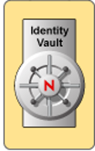


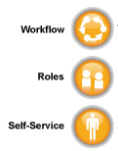



Current Integration
Roles & Policies
User Store
Role-based
Access
IDM
Access Manager
Current State: Manual Integration!

Slide 3





Scenario 1: Basic User Access
Access Manager
1
3
User logs in
RBAC
2
Get Roles for this User
IDM REST API
Out of the box integration.
Avoid complex NAM configuration for simple use cases.
Single point of configuration.

Slide 4
Scenario 2: Advanced Configurations
Invoke IDM REST API to get all configured roles.
List these roles on Access Manager UI for creating complex configuration.
To create complex policy using multiple roles
To restrict access using a role name

Slide 5
Summary
Automates straight-forward scenarios
Simplifies management
Reusable solution for integration with other products.

Slide 6
Demo

